Slide 1
KORDZ-Music for everyone
By:
171, Jainamkumar Patel
169, Deep patel
119, Jayneel Desai
170, Hastee patel
155, Khaliq Minsariya

Slide 2
Overview
Music streaming services or applications (apps) collectively spin billions of songs for millions of listeners on daily basis.
Music streaming apps have very complex user interfaces which make it difficult for the users to navigate through, consequently hampering the overall entertainment process. Additionally, it lacks features that otherwise users would expect the app to have such as downloading songs to their preferred location in the device. Moreover, it doesn’t cater for all users for example, Spotify (existing music app) only allows signing-up through Facebook and not other social media platforms.
Kordz design comes with different interactions, features, also with some new enhancements and improved user experience compared to the current music apps which are already in the market.

Slide 3
Problem at Hand
They have complex user interfaces which is difficult as well as inconvenient to use.
Tracks/music are downloaded on the app and not on the device’s local storage.
Creating accounts through social media is limited to Facebook only.
Search option is very basic and outputs broad results.
Shows recently and mostly played playlists but not individual songs.
Does not give any information about artists.
Does not display lyrics as song is playing.
No option to synchronize music with other devices.
Kordz aims to solve the above issues.

Slide 4
Stakeholders
Stakeholder Type | Stakeholder Name | Stakeholder Actions
Primary | Music enthusiasts (students, adults, elderly people) | They use the app actively in the course of their lives to listen to music
Secondary | Artists/music composers | Their music is uploaded to these apps. Plus, their information such as upcoming concerts is also posted.
 | Developer team | They constantly work on the app to maintain it and render updates.
Tertiary | Organization/owner | The app’s success affects the organization’s profitability.
Notes:
Music is a form of expression loved by many. But a music app is something used by all. The users of our music app can be divided into 4 categories. This would include Stakeholder, primary user, secondary user, and even tertiary users. Our Stakeholder would include the big people behind the app. This would include the company itself, the project manager, the interface designer, the music recommender and production team. But most important the artist. Our primary user would include the music lover and the prime members of the app. As they are the frequent hands-on user of the system. Secondary user would include the background user, these are individual who use the app, but not as often or don't care about the app as long as they may continue to listen to music. The tertiary user is the guest, in other words the one-time user, or the user there to just try the app out. Tertiary user also influences the purchase of the product.
i

Slide 5
Requirements: User Characteristics
Stakeholder Type | Stakeholder Name | Educational Level | Computer Expertise | Age Range | Frequency of use
Primary | Music enthusiasts | High school to university level | Medium to high | 12+ | High
Secondary | Artists | High school to university level | Medium to high | 18+ | Medium
 | Developer team | University level | High | 20+ | Low
Tertiary | Organisation | University Level | High | 20+ | Low
Notes:
Characteristic of user is method used to determine more about the user group. Each of the user in our interface usage can be examined under 5 categories. Which include educational level at minimum, computer experience/ knowledge, age range, user usage and more information. More information is a category that states the effect of the user on the product.
First off let’s begin with our Stakeholder. The educational level our of stakeholders are university level. This individual will have the highest possible computer knowledge, as for most part they would be the designer and manager of the product or have high knowledge regarding the product. They would range in age from 18+ and would have a user usage rate of daily. Because stakeholder include project manager, company owner, production team and etc., they monitor the interface 24/7, allowing them to have the highest usage. As mentioned, early stakeholder is the one to control the performance of the interface, it's up to them to allow when the music will be available or not.
Secondly, we have the primary user, these users have an educational level of high school. They also have a high computer experience as they would protentional know all the shortcuts. But they also have a medium experience of computer, this would include user who are there for just good music. The user age would range from the 16+ and also, they would have a daily user usage. But they won't be using it 24/7, but they're usage would range for most part of the day. The impact of a Primary user on a product can be categorizes as a “1st class usability tester”. Because primary user would use the app on a daily basis, they would be able to figure out all the major and small problems of the product.
The secondary user has an educational level of a middle school. They have about medium to low computer experience, as they have the basic ability to perform actions, and simple edits. They would range in the age of 12+ and will use the product often. This usage range is about 2-3 day a week. Secondary user could also be known as “2nd class usability tester”, based on their impact of the product. Even if the user uses the product often, they would still be able to find the faults of the product, the only thing is they would be able to find just the simple mistakes.
And last but not least the tertiary user. The tertiary user would have an educational level similar to the secondary user, which is Middle school. They have a medium and low computer experience as for they have and will only care form the basic information and simple edits. The age of this user would range from 12+ and are just one-time user. Based on the reason that tertiary user is just one-time user, they are the ones to evaluate the product, based on this evaluation of their they would be able to spread good or bad words to the “possible” users. In other words, their “free marketing people”.

Slide 6
Requirements: User Goals
User | Functional Goals | Non-Functional Goals
Music enthusiasts | - Add/ remove music to/from playlist - Browse music - Log on/ sign up access Download music - Listen to music - View lyrics | - Security of data - Performance of app - Easy usability of interface - Reliability of app (interruption free streaming)
Artists | - Add music to app - Add their information to app - Add lyrics - Log on/ sign up access | - Security of data - Reliability of app
Developer team | All functional goals combined | - Security - Performance - Usability - Reliability
Organization | - Log on/sign up access - Browse music - Add/remove music to/from playlist - Download music - View lyrics - Listen to music | - Security - Performance - Usability - Reliability
Notes:
Functional Goal are sometime similar and somewhat different for all the users, they are specific behaviours of the system. The stakeholder has the functional goal to add music to the app, add/ remove music from playlists, browsing music and logging in or sign up for access. The primary and secondary user has the functional goal to add/ remove music, browse music, login and download music. Whereas the tertiary user has the goal to browse music, login and download music.
The non-functional goal of a stakeholder, primary, secondary, and tertiary user is to ensure security of the user’s data and the performance of system in peak hours. Addition the stakeholder has the non-functional goal to ensure maintenance and regulation of the app. The Primary user has an addition non-functional goal of capacity (how many songs can be held in the playlist) and manageability (easy to use). The secondary user has the same addition non-functional goals and the tertiary user.

Slide 7
Context of Use
Physical:
May not be able to use in areas that are too noisy (especially without earphones/headphones).
Social:
App can be used privately if using ear/head phones or even in as a group through speakers.
User can connect to other devices within the same location or across locations.
Notes:
The possible environmental factors that would affect the users' ability to interact with the system are app speed, Ease of Comprehension, Efficiency, Intuitiveness and Learnability. App speed is how long it take for the page or app to load. Ease of Comprehension is how the content of product is easy to understand and operate. Efficiency is the ability to ensure that the product is improved and present limited amount of errors. Intuitiveness is how easy is it for the user to navigate themself through the app and accomplish a task. Learnability allows the user to easy learn the interface and perform a task with ease. For example, when the user sees the add icon, they know if they press on it, they will be able to add that song to the playlist.

Slide 8
Other Factors to Consider
Multiple platform usage of device
Device being used in different main platforms, for example; Android, iOS, Windows Phone and MacOS
Screen Size
work with a screen size that far exceeds that of mobile devices.
Internet connection
Cannot browse music without internet connection. Saved songs may be played although.
Notes:
Other factor to consider in the context of use of the interface is the multiple platform usage of the device. This would include allowing the interface being available on main platforms, such as Android, iOS, Windows and MacOS. Another factor to consider is Screen size. This means that the interface is adaptable with a screen size that exceeds the regular mobile device screen size. For example the interface is usable on different mobile sizes, laptops screen sizes and even bigger monitors.

Slide 9
Tasks
Task 1: login or sign up using the various methods provided.
Step 1: Open application on device.
Step 2: Click on appropriate button to either sign-in or sign-up.
Step 3: Click on the appropriate social media icon displayed to sign-in/sign-up with your social media account or enter username and password in the fields presented.
Notes:
When the user start the system for the first time they will be prompted by a sign in or sign up page
They will be able to use any of the top social media platforms to sign in and have easier access to share songs on their preferred social media outlets

Slide 10
Tasks
Task 2: Search for songs
Step 1: Click on search icon on the navbar at the bottom.
Step 2 (Basic search): enter song to search in search bar and results will popup below.
Step 3 (Listening for songs): Click on “Listen for songs” to search the song playing around you.
Step 4 (Advanced search): Click on “Advanced search” and input text in the text fields as well as select options from the drop down menus and click search.
Notes:
Through the UI and the search icon the user can search for specific songs by their names, part of their lyrics or even their artists.
But they can also find songs by navigating through the UI and selecting/filtering through genres, artists etc where the system will then recommend them songs according to their filter

Slide 11
Tasks
Task 3: Find automatically generated and user created playlists on the home page
Step 1: Navigate to home page by clicking the icon on the navbar at the bottom
Step 2: The home page displays recently and most played songs grouped respectively. These are created automatically depending on user activity. User created playlists are displayed below the automatically generated playlists.
Notes:
As the user enjoys their music the system will automatically created playlists depending on their favourites, their recently played or even playlists they created which can be found on the homepage for easier and quick access

Slide 12
Tasks
Task 4: View specific artist information
Step 1: Click on any hyperlinked text called “Artist Name.” They are found in several locations in the user interface. The home page, search results, or “Playing Now” page.
Step 2: Click on “top songs” to view that artist’s popular songs.
Step 3: Click on “albums” to browse that artist’s albums.
Step 4: Click on “upcoming” to view songs coming soon as well as any planned concerts.
Notes:
The user can search up artists or select artists by the song they are listening to and find further information about the artists, their upcoming event and any other relevant news about the artists

Slide 13
Tasks
Task 5: Sync with other devices.
Step 1: Navigate by clicking the third icon on the navbar at the bottom
Step 2: Enter username of person who you seek to pair with and click request button to send a request.
Step 3: Upon accepting the request the device(s) connected to will be displayed under “Connected Devices.”
Step 4: Click on appropriate icons to accept/reject request or to remove a connected device.
Notes:
For example, Playing the same song on multiple devices at the same time, at the same location or at different locations.
If the system identifies multiple devices connected on the same account the user will be prompted with these additional options

Slide 14
Tasks
Task 6: View lyrics of the current song playing
Step 1: Navigate to “Playing Now page” which can be done by clicking various appropriate links in the user interface.
Step 2: Click on the “eye” button to display lyrics or click on the “crossed eye” button to hide lyrics.
Step 3: Follow through lyrics as song continues to play. The lyrics already sang get highlighted to allow user to easily follow the song.
Notes:
Option on the UI will be dependant on whether the artists uploaded the lyrics or not, or if the system was able to generate the lyrics

Slide 15
Tasks
Task 7: Hide/Show menu that displays current song playing.
Step 1: Click on the 3 arrows pointing left to hide the menu.
Step 2: Click on the 3 arrows pointing right to show the menu.

Slide 16



Metaphors and Analogies
User logo – the logo is tuned to fit the context of the app. It consists of a person with headphones and a music disk as opposed to just a person.
“Listening for music” image – the headphones with music bars in between represents searching for song playing around the user.
House icon – represents home page button
Magnifying glass – represents search button
Two screens with wireless connection symbol – button that navigates to the page that connects to other devices.
Eye and crossed eye symbol – view/hide lyrics

Slide 17
Conceptual Model and Design Approach
Internal Consistency:
Colour scheme will be the same
Underlined text to represent links throughout
All screen’s will have navigation bar at the bottom
Using same designs for all buttons
Using same type of text fields throughout
Notes:
Jainam:
Colors will be same throughout the design.
Fonts will be different for both the headings and subheadings. Refer to the photo in side
Bottom navigation consists of “HOME” “EXPLORE” “SEARCH” “DOWNLOADS” for user to easily navigate through the app

Slide 18
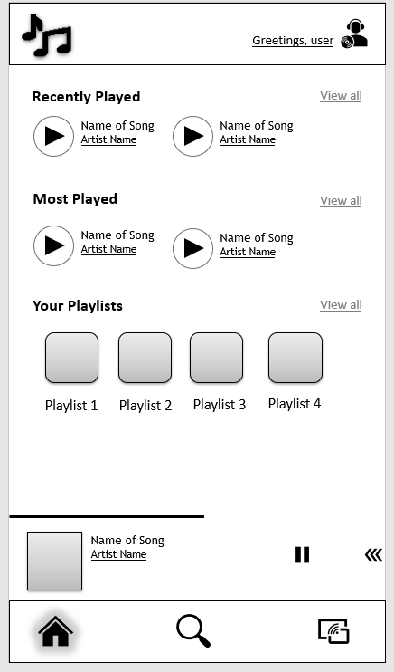
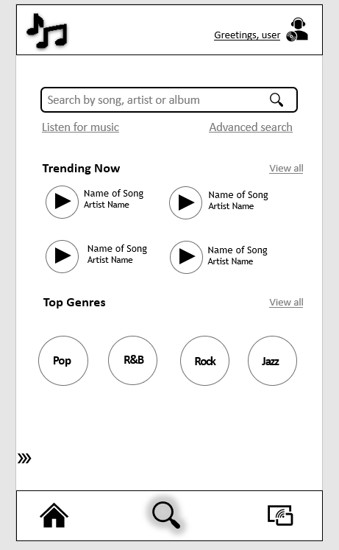
Internal Consistency
Same color scheme
Same Navbar

Slide 19

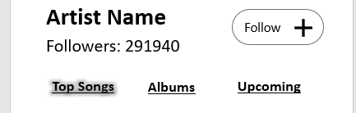
Internal consistency
All links are underlined

Slide 20
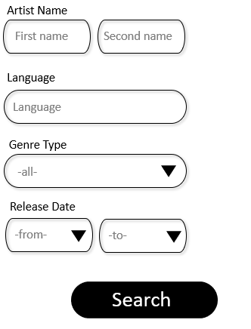
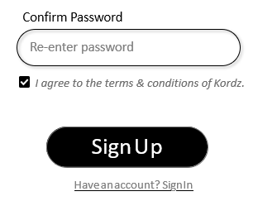
Internal Consistency
Same text fields
Same button design

Slide 21
Conceptual Model and Design Approach
External Consistency:
Common icons used for effective interaction and easy learnability.
Download, Favourite, Skip, Fast-forward and etc...
Consistent social media icons
Having navbar at the bottom is consistent with other music applications
Menu to display current song playing is consistent with other music apps
Notes:
Jainam:
These are the icons that a normal user is familiar with so using them was the right choice.
Download icon → downloads the songs
Favourite icon → adds the song in the “favourite” section of the app
Rather than clicking view all, the user can scroll up/down on the same screen to see the next 6 songs. It saves 1 extra step

Slide 22
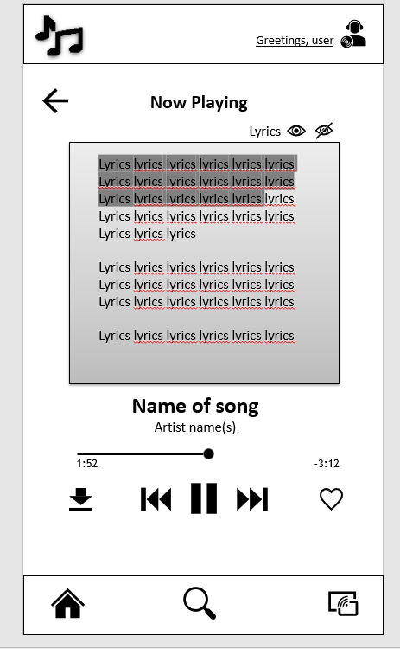
External Consistency
Common icon to download to local storage
Common icon to save song
Common controls for play/pause and previous/next song
Navbar at bottom – consistent with other apps

Slide 23
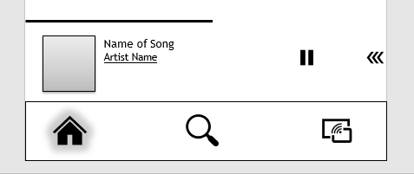
External Consistency
Menu to display current song playing – similar to rival apps
Consistent home and search icons

Slide 24
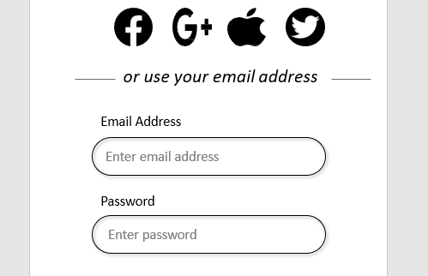
External Consistency
Consistent social media icons

Slide 25
Conceptual Model and Design Approach
Feedback
Navbar icons highlighted when selected
Links highlighted when selected
Lyrics that are already sang/played are highlighted
Save icon changed when user saves that song
Notes:
Jainam
Sime hover effect on the buttons so the user knows
Pop-up confirmations will be on the screen for roughly 5 seconds letting the user know the action has started/completed
“Added to favorites”
“Album downloading” → “Album downloaded”
If a new song/album has been uploaded by user’s preference, the “explore” icon will light up

Slide 26






Feedback
Links and navbar icons highlighted when selected

Slide 27
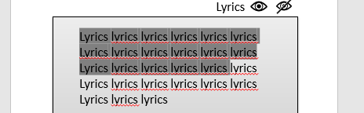
Feedback
Lyrics already sang/played
Upcoming lyrics

Slide 28
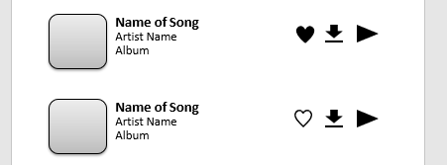
Feedback
Save icon after user interacts
Save icon before user interacts

Slide 29
Conceptual Model and Design Approach
Constraints
When user enters text in the search bar, results pop-up in a small window below the search bar that blurs the background so user can focus on the results provided.

Slide 30
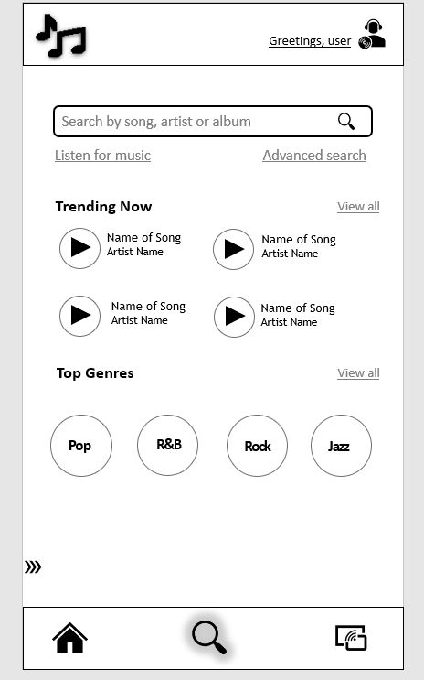
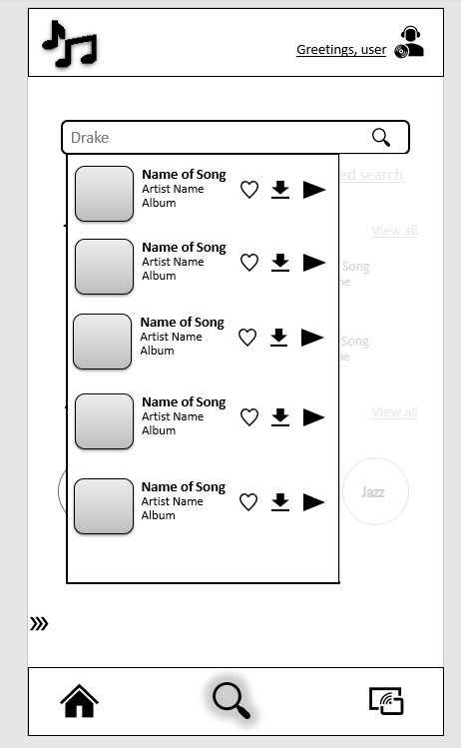
Constraints
Search page before
Search page after – background blurred

